Slide 1

ICMP Ping Client
Huang Hao, Zhou Yitong, Meng Yu, Chen Zijie, Wen Tianshu
2024.10.24

Slide 2
CONTENTS
Introduction of Traceroute
01 Preparation
Divide of tasks
02 Traceroute
CONTENTS
Packet construction
03 Packet
Send packet
receive packet
04 Test
Version control
05 Conclusion
Summarize functional implementations

Slide 3
01
PART
Preparation

Slide 4






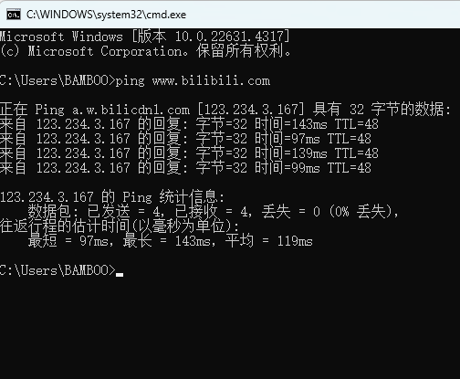
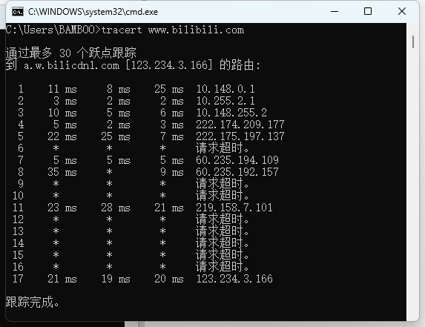
Prepare
traceroute
packet
test
conclusion
Traceroute VS Ping
Ping
Traceroute
Send packet
+
Receive packet
Whether the packet can reach the destination
Where is the packet going

Slide 5
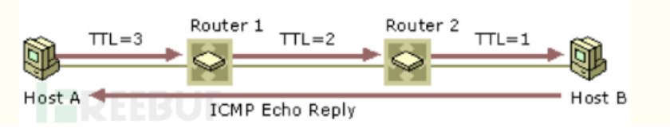
Prepare
traceroute
packet
test
conclusion
Introduction of Traceroute
Function：
If we can’t reach to HostB
Traceroute can:
Find out which device on the path is the problem

Slide 6
Prepare
traceroute
packet
test
conclusion
Division of tasks
Huang Hao
Getting through the code framework
Multi-threaded & RTT visualization
Logs store by json/csv
Windows & Linux testing
Meng Yu
Checksum calculation
ICMP & UDP packet management
Customize user input
Zhou Yitong
Beautify output
Traceroute process design
Windows testing
Wen Tianshu(presentor)
send & receive packet
Calculation of RTT
Chen Zijie
Functional testing with wireshark
Calculation of packet loss rate

Slide 7
02
PART
Traceroute
process

Slide 8


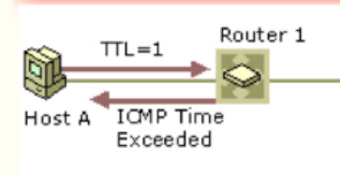
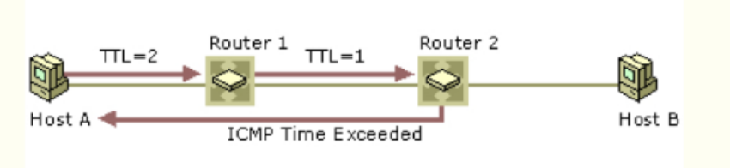
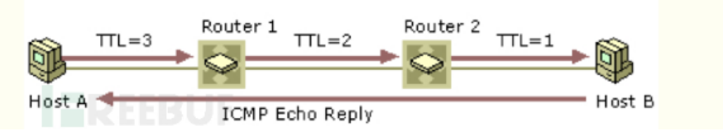
Prepare
traceroute
packet
test
conclusion
Traceroute Process
set socket
Tracert multiple TTL
extra
send packet
ICMP
------
create packet
Tracert
---
UDP
Animate (Real-time plotting)
functions
receive packet
---
Identity Error / Hostname+addr
(icmp_type)
TTL=0
Send ICMP:
Send UDP:

Slide 9
03
PART
Packet

Slide 10

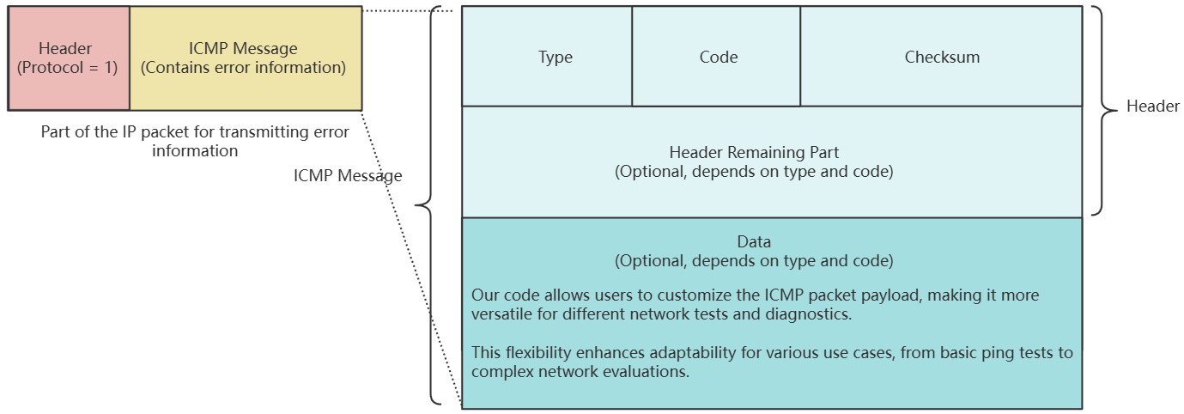



Prepare
traceroute
packet
test
conclusion
UDP Packet Creation Explanation
ICMP Packet Composition
1. The packet consists of two main parts: the header and the data.
2. The header includes essential control information like Type, Code, Checksum, Packet ID, and Sequence Number.
3. The data section contains user-defined data, often used for diagnostic purposes like timestamps or padding.
bbHHh Explanation
Header & Data
b: 1 byte for the Type field (e.g., Echo Request or Echo Reply).
b: 1 byte for the Code field (specifies the subtype of the ICMP message).
H: 2 bytes for the Checksum (used for error checking).
H: 2 bytes for the Packet ID (to match requests with replies).
h: 2 bytes for the Sequence Number (helps track packet order).
1. The header stores the control and identification information required for ICMP communication (Type, Code, Checksum, Packet ID, Sequence Number).
2. The data section holds additional information, such as timestamps or any other diagnostic data needed for the echo request and reply process.

Slide 11
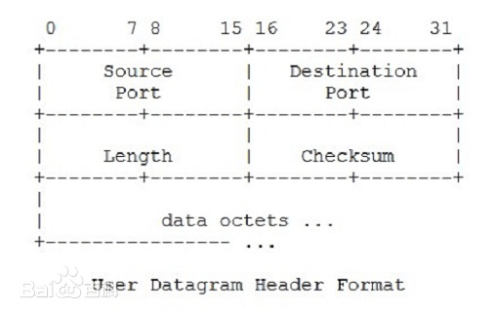
Prepare
traceroute
packet
test
conclusion
UDP Packet Creation Explanation
create_udp_packet Function
1. Defines Source and Destination Ports: Sets both the source and destination ports to 33434.
2. Generates Random Data: Creates a 32-byte random payload using os.urandom(32) for the packet's data.
3. Calculates Total Length: Computes the total length of the UDP packet, which is the sum of the header size (8 bytes) and the data size.
4. Initial Header Creation: Constructs the initial UDP header with the source and destination ports, total length, and a temporary checksum set to 0.
5. Checksum Calculation: Calls a function to calculate the checksum using the UDP header and data for integrity verification.
6. Updates Header with Checksum: Repackages the UDP header with the correct checksum value.
7. Returns Complete Packet: Combines the final header and the data payload, returning the complete UDP packet for transmission.

Slide 12
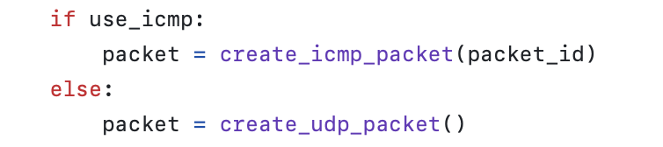
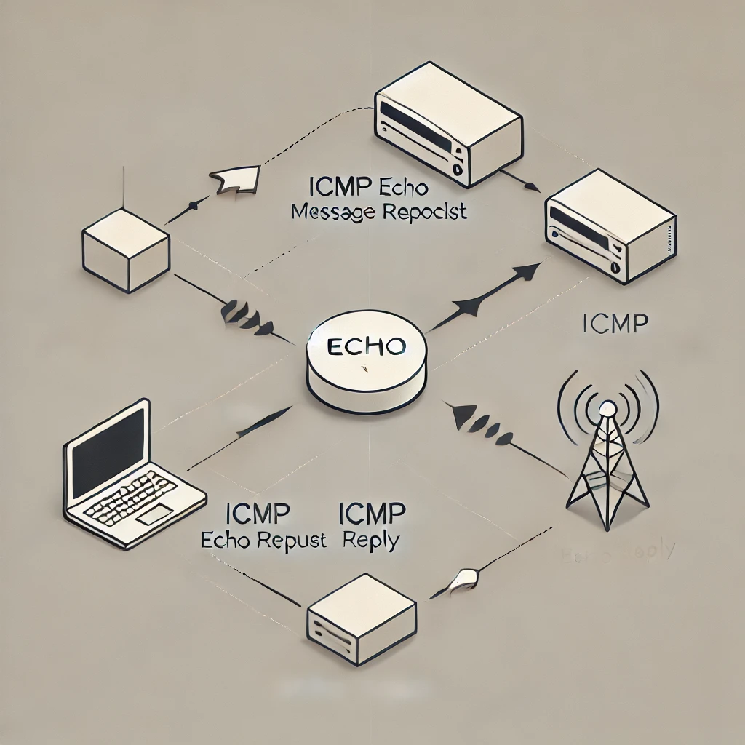


Prepare
traceroute
packet
test
conclusion
ICMP - Send & receive
A process used to get information
We record these as well：
Whether we are using ICMP or UDP, we have to decide what to do with this information by identifying the type and code

Slide 13
04
PART
Testing

Slide 14





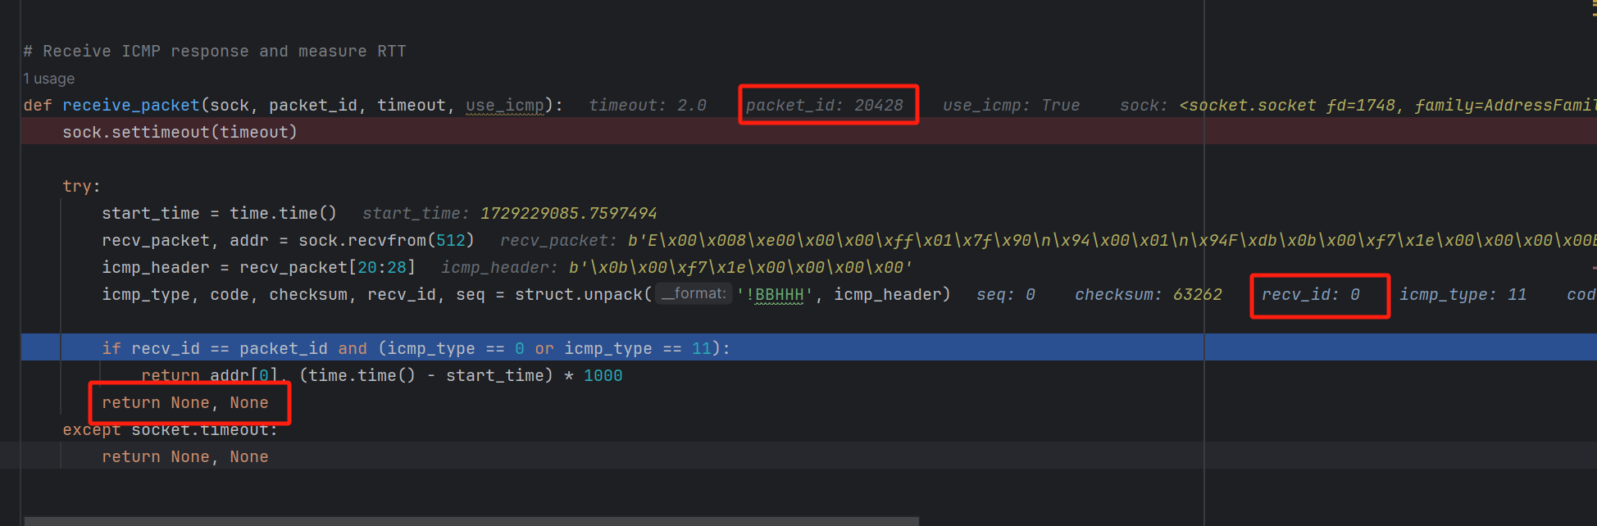
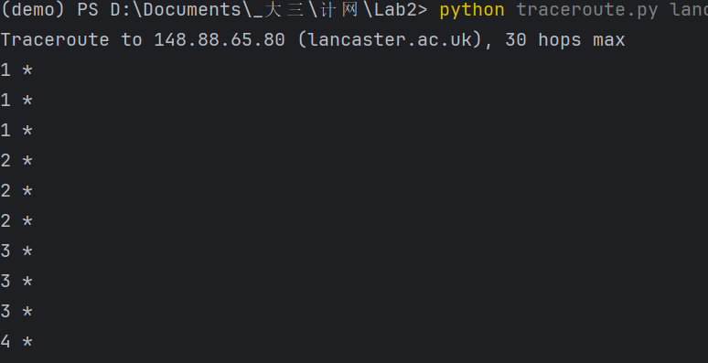
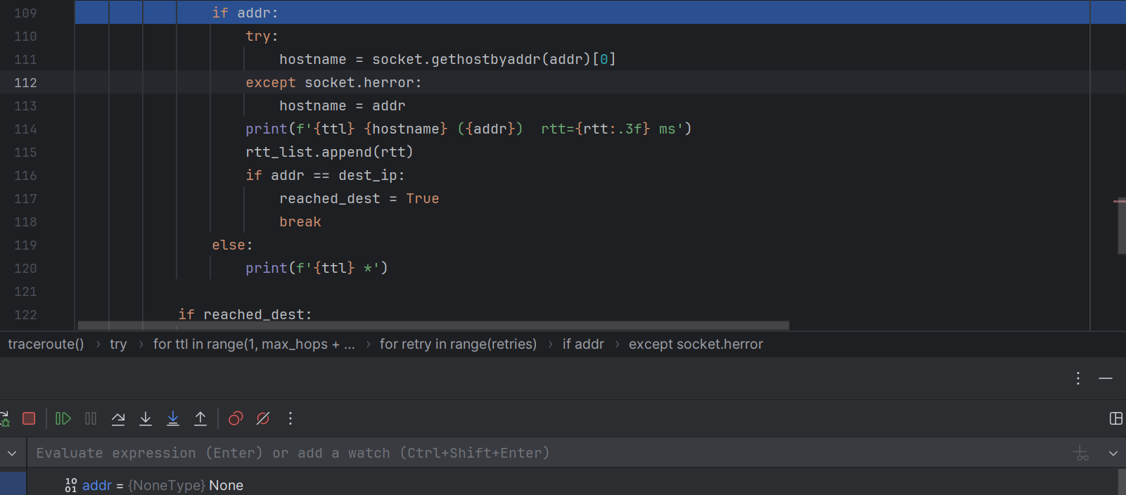
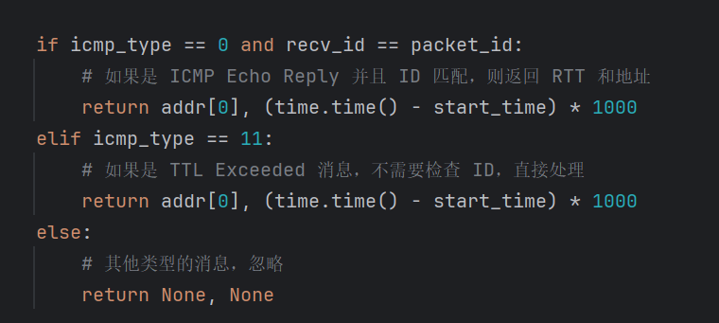
introduction
traceroute
packet
test
conclusion
Multiple problems have been solved
1. addr is None:
:
Possible Solution:
When TTL exceeds, there is no need to strictly judge packet_id == recv_id

Slide 15
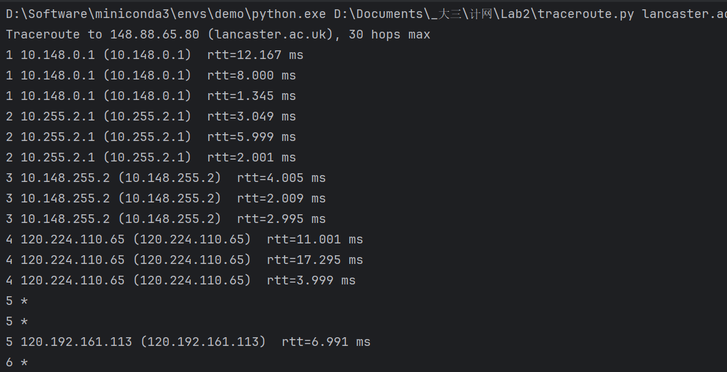
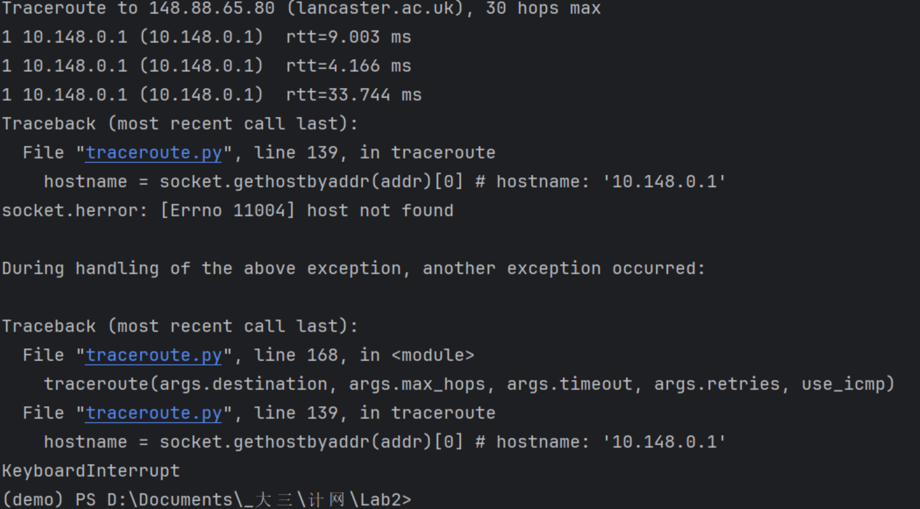
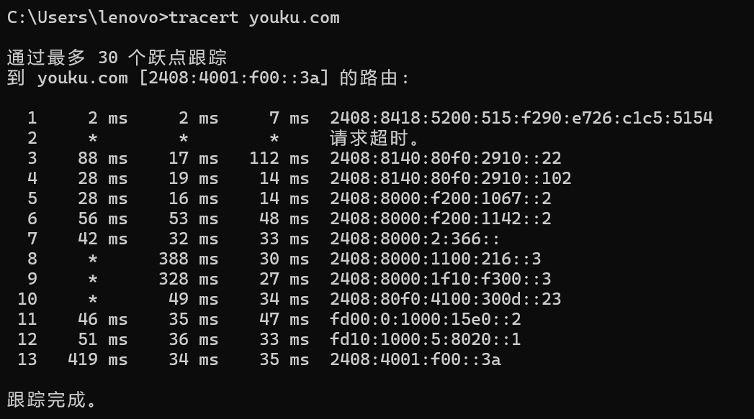
introduction
traceroute
packet
test
conclusion
Multiple problems have been solved
2. Network problem:
Should close the proxy
The local traceroute may also time out.

Slide 16
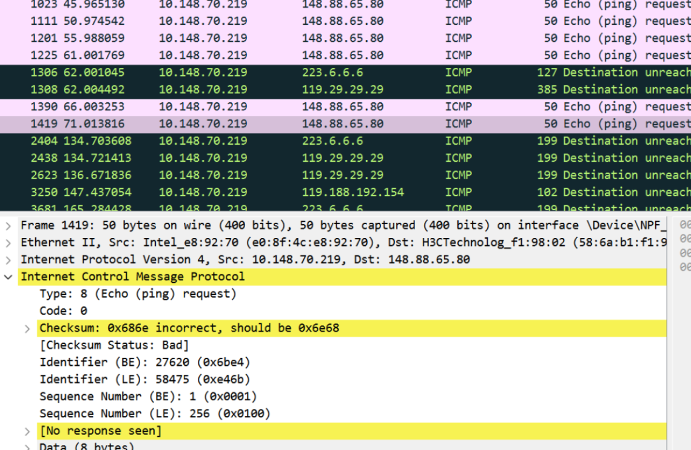
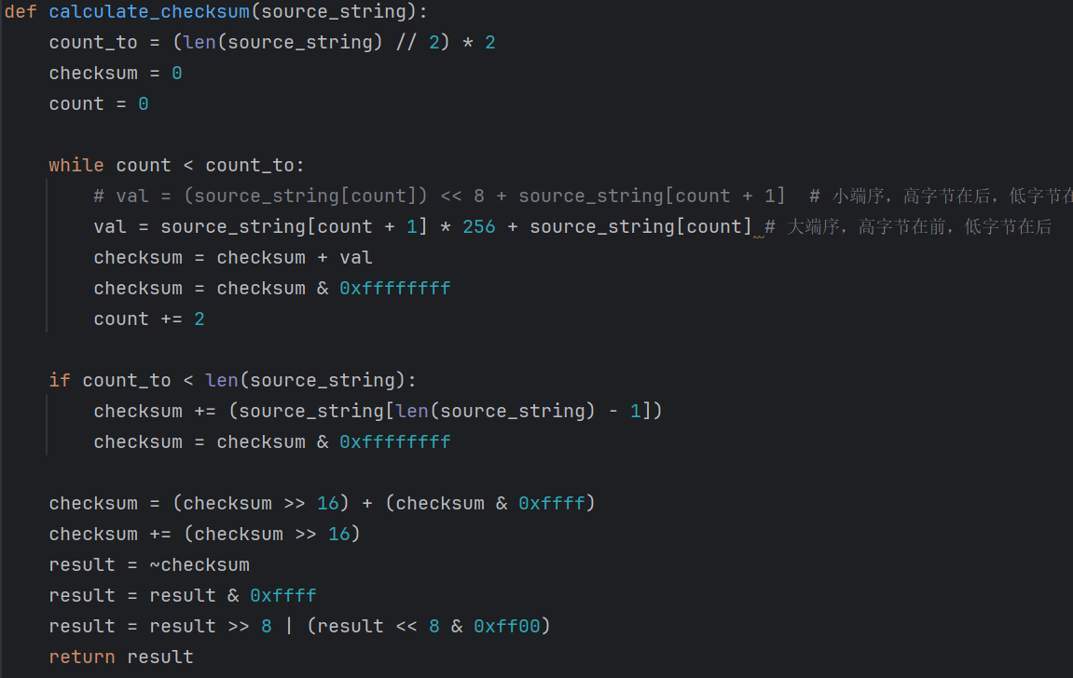
introduction
traceroute
packet
test
conclusion
Multiple problems have been solved
3. Incorrected checksum:
Possible Solution:
Switching to Big End Sequence

Slide 17
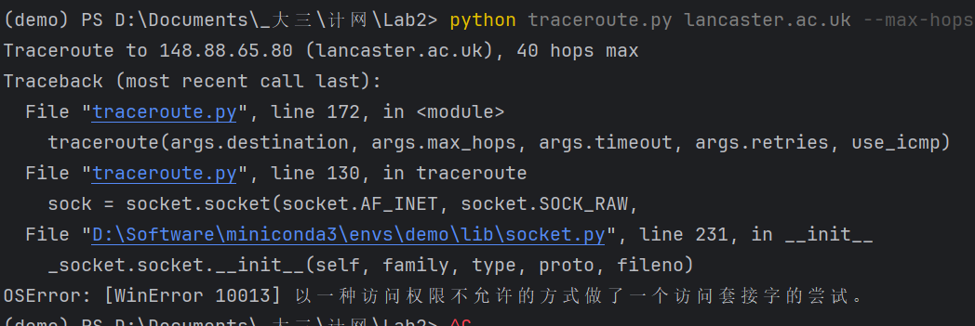
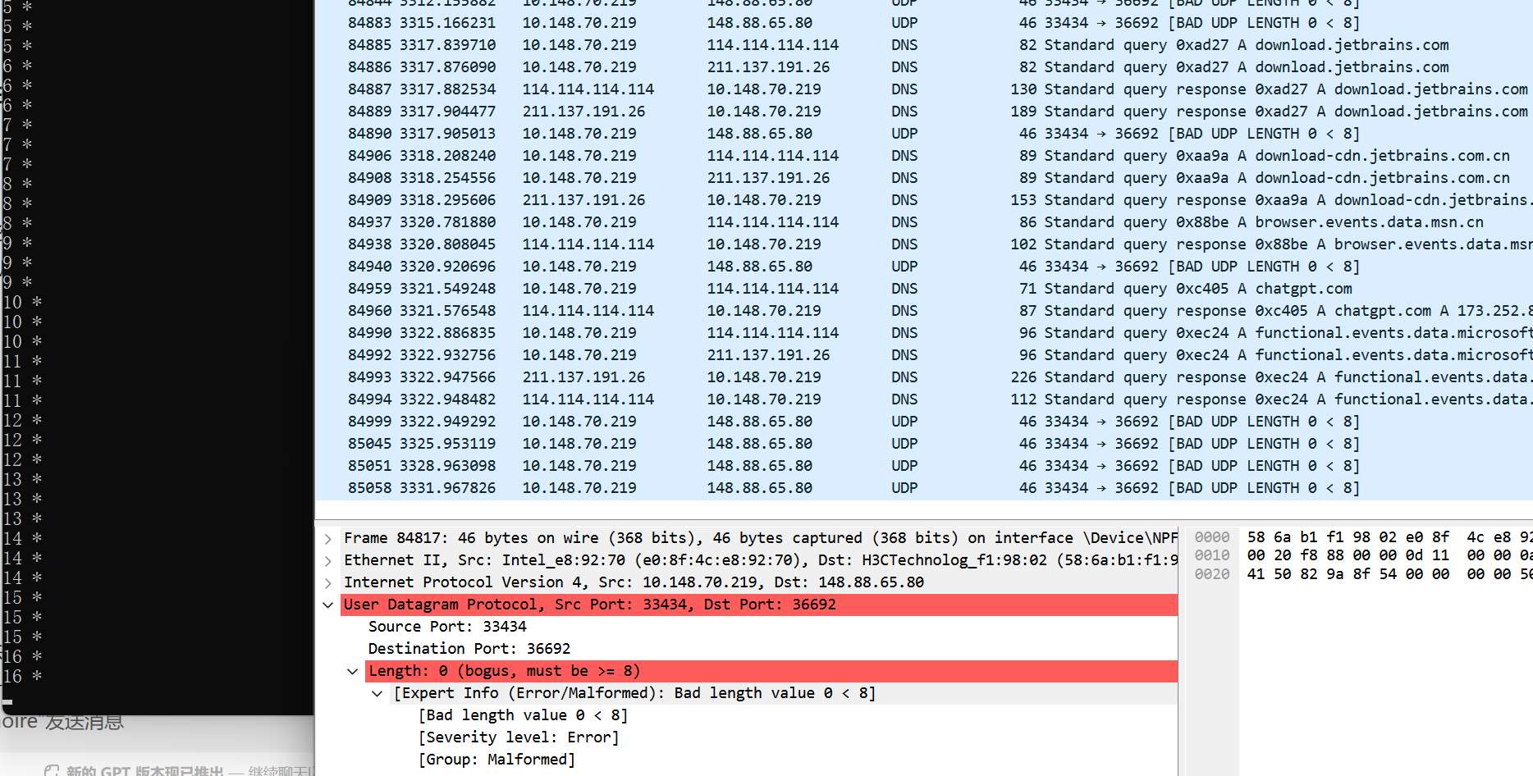
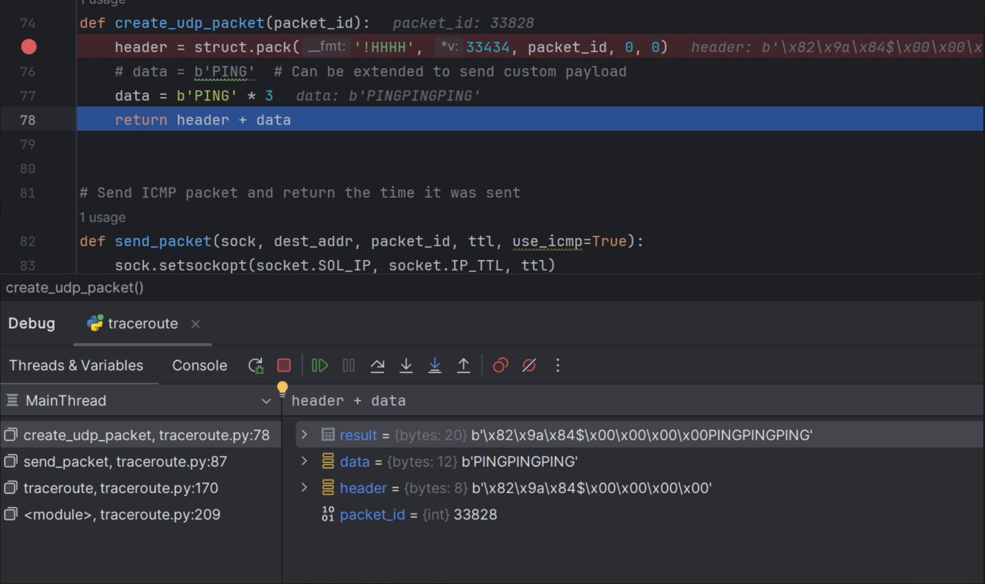
introduction
traceroute
packet
test
conclusion
Multiple problems have been solved
4. No permission to access & packet length is 0 .
Possible Solution:
Run as administrator

Slide 18
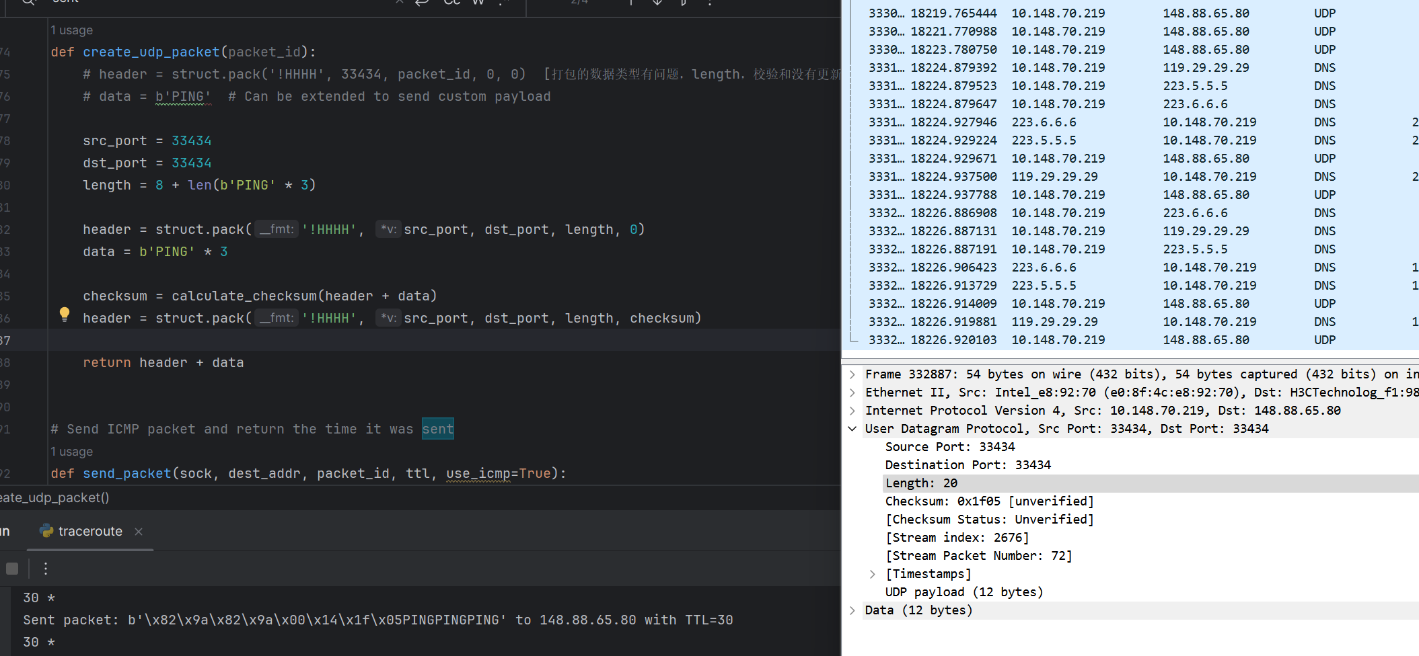
introduction
traceroute
packet
test
conclusion
Multiple problems have been solved
Solution:

Slide 19
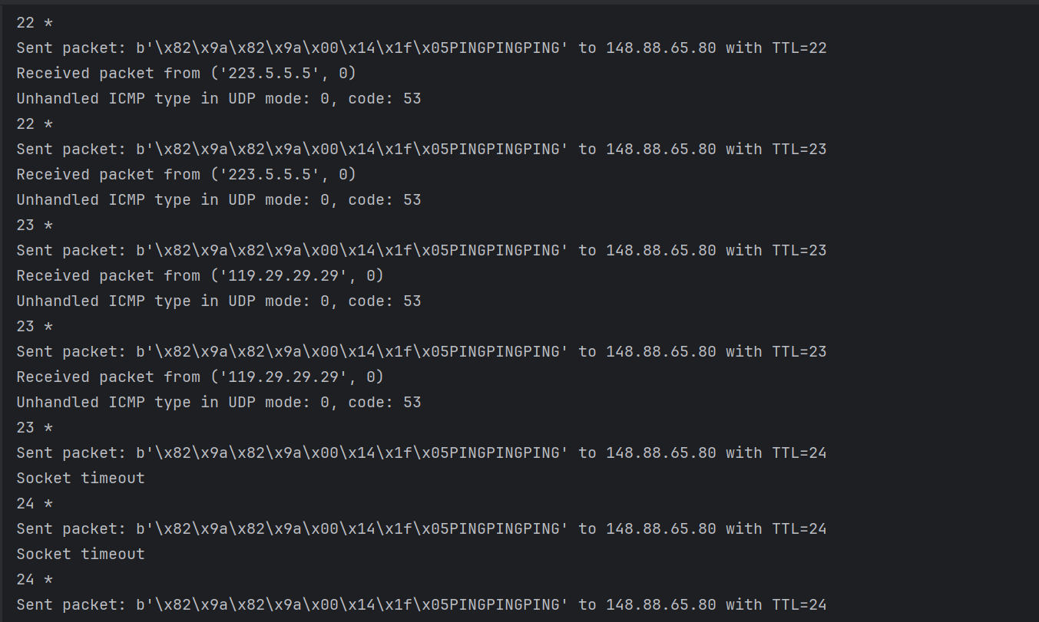
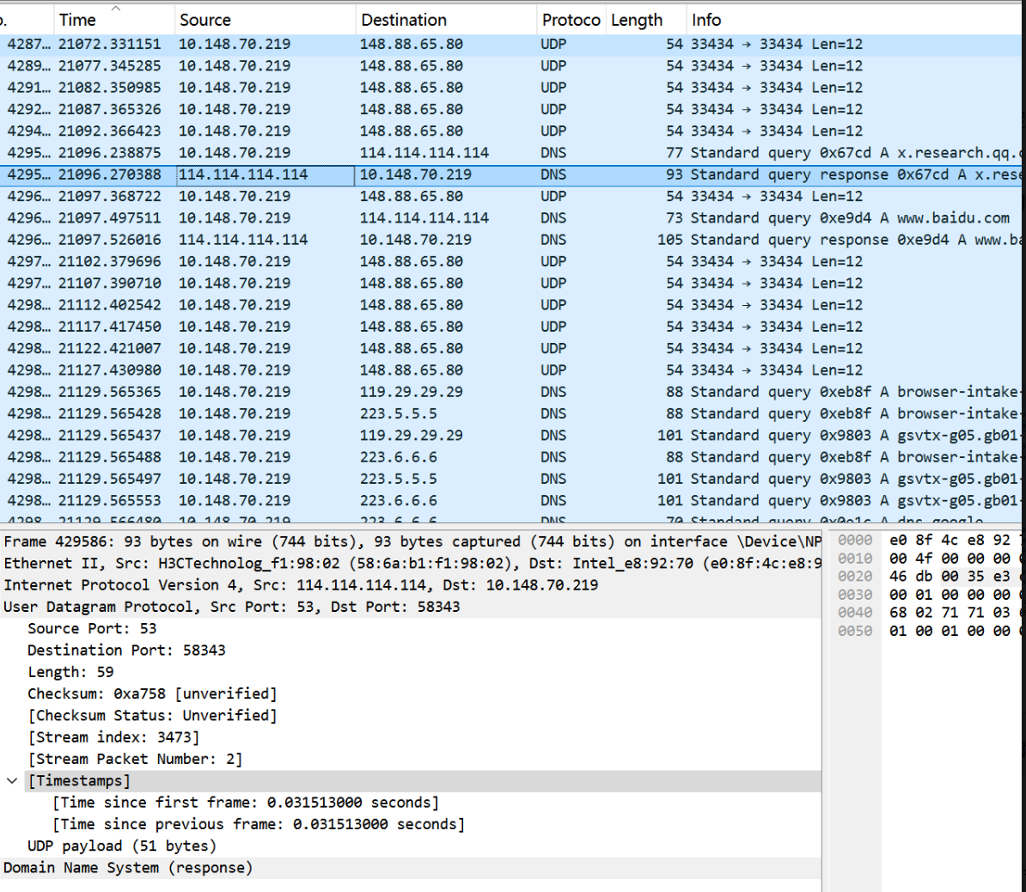
introduction
traceroute
packet
test
conclusion
Multiple problems have been solved
5.UDP protocol: icmp_type=0, code=53 -> The returned packet is of DNS type
UDP： icmp_type=0，code=53
socket timeout is a network problem. Cancel the proxy.

Slide 20
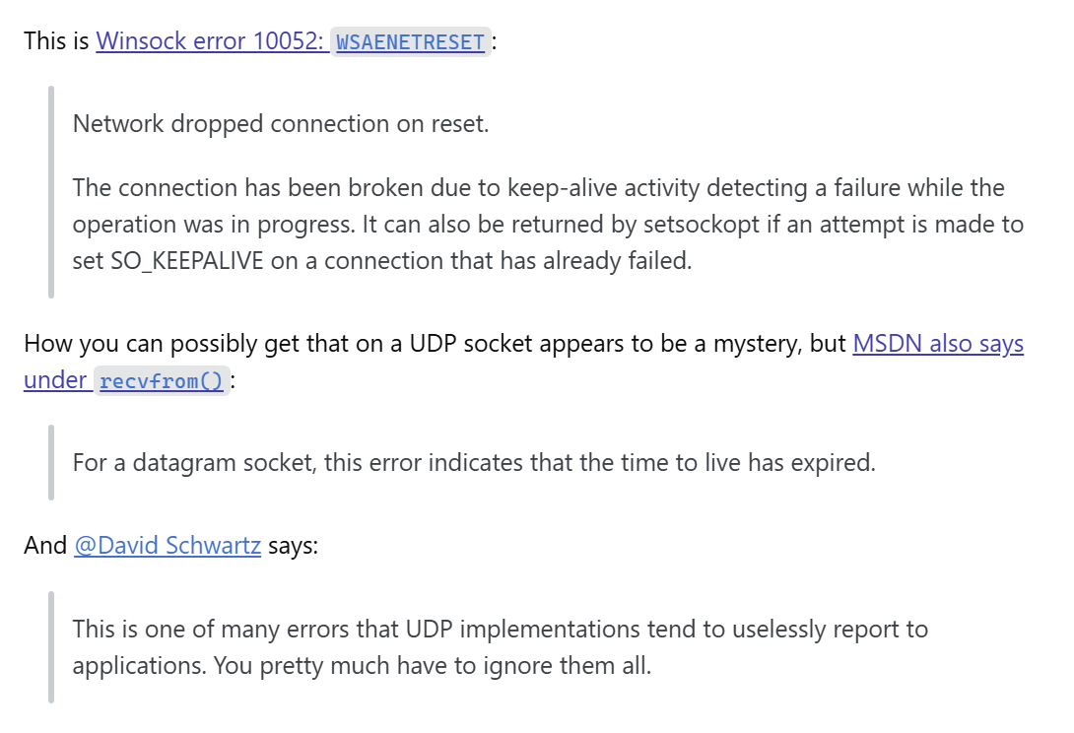
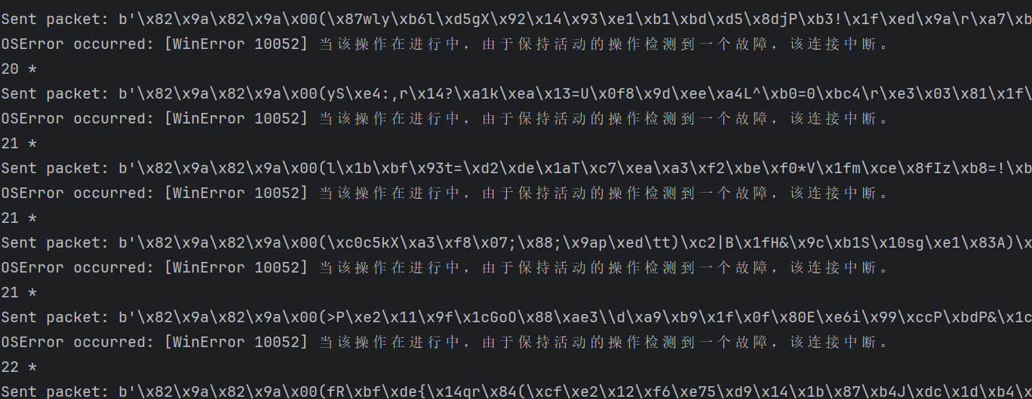
introduction
traceroute
packet
test
conclusion
Multiple problems have been solved
5. icmp_type=0, code=53 -> The returned packet is of DNS type
Possible solution in community:
Switch Socket：SOCK_RAW -> SOCK_DGRAM
Microsoft Development Documentation:

Slide 21
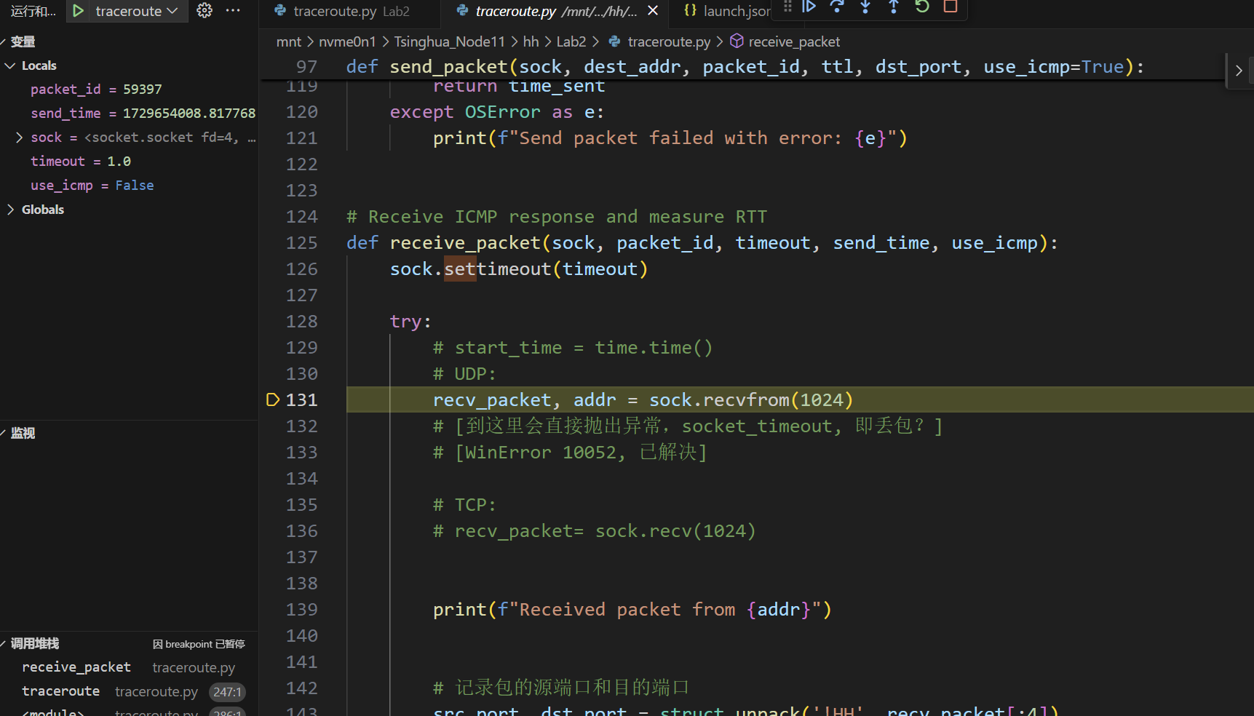
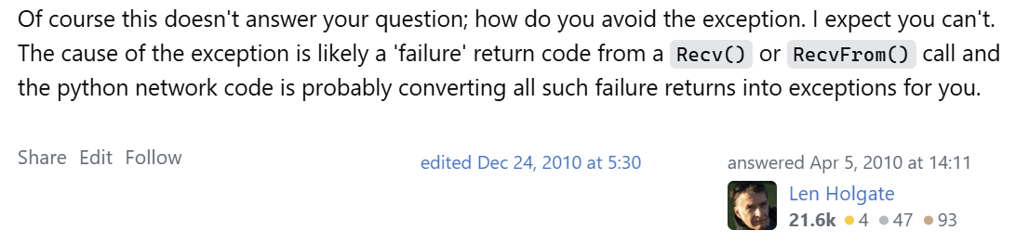
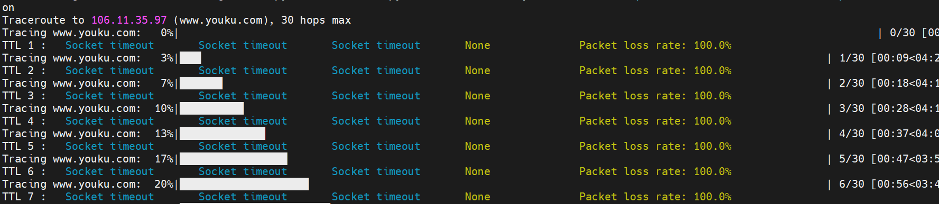
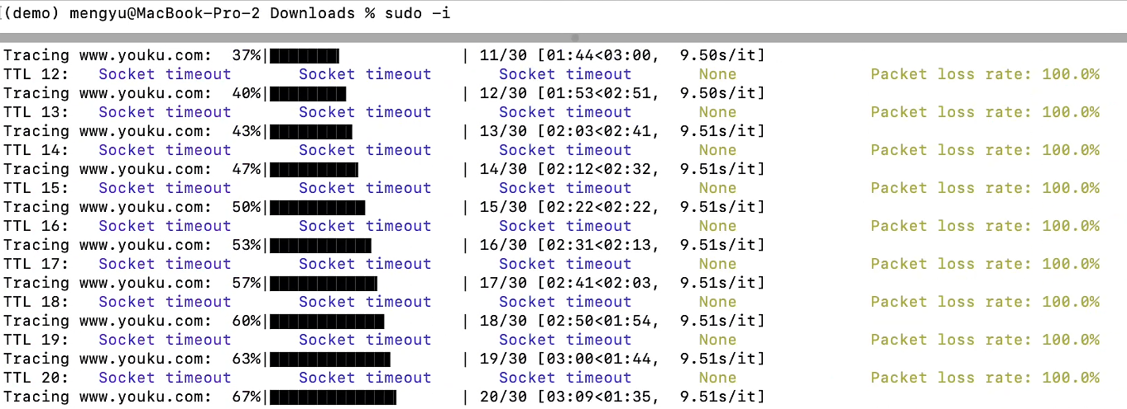
introduction
traceroute
packet
test
conclusion
Multiple problems have been solved
Furthurmore:
Switch OS：Windows -> Linux -> Mac
New Error occured: WinError 10052 -> Socket timeout
Possible solution in community:
No solution!
Linux:
Mac:

Slide 22
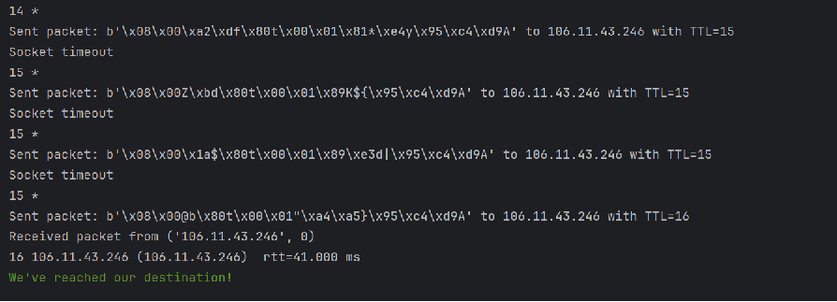
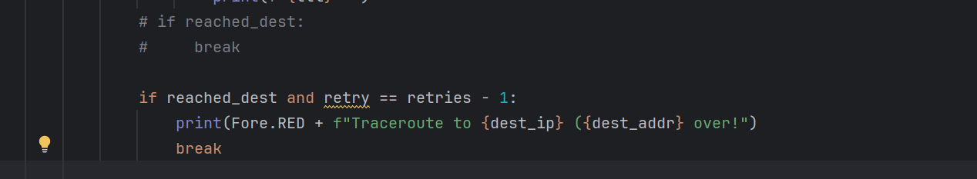
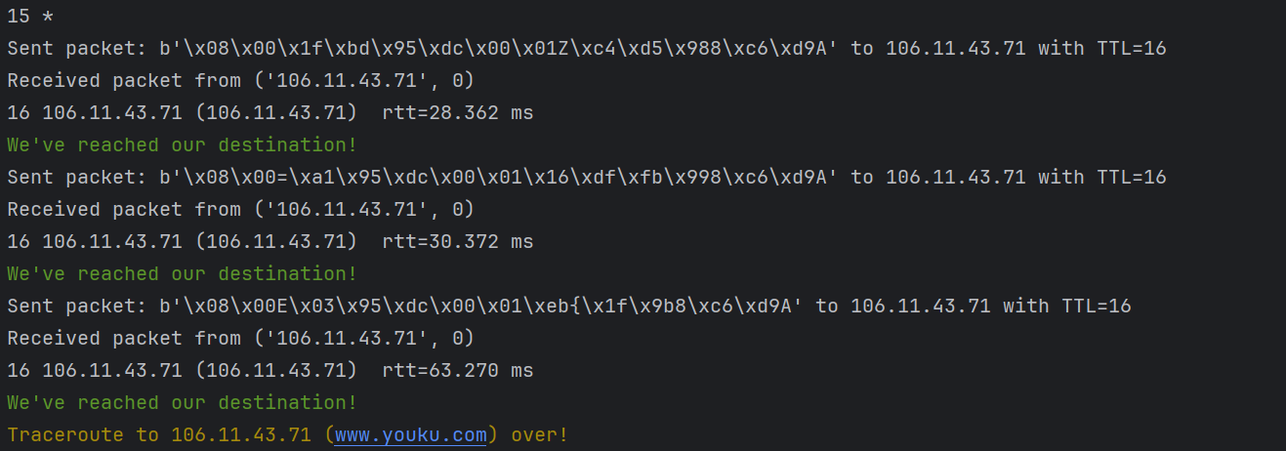
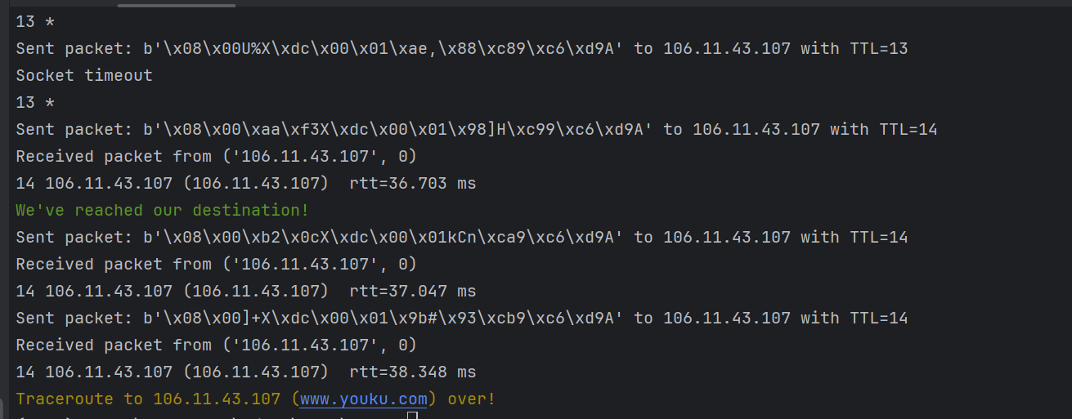
introduction
traceroute
packet
test
conclusion
Multiple problems have been solved
6. 到达目标主机后只返回一次TLL（不返回retries次）
Possible solution:
Add a new constraint condition:
Successfully returned the retries sub-TTL
But 重复打印“We’ve reached our destination”
Add a local stop flag:

Slide 23
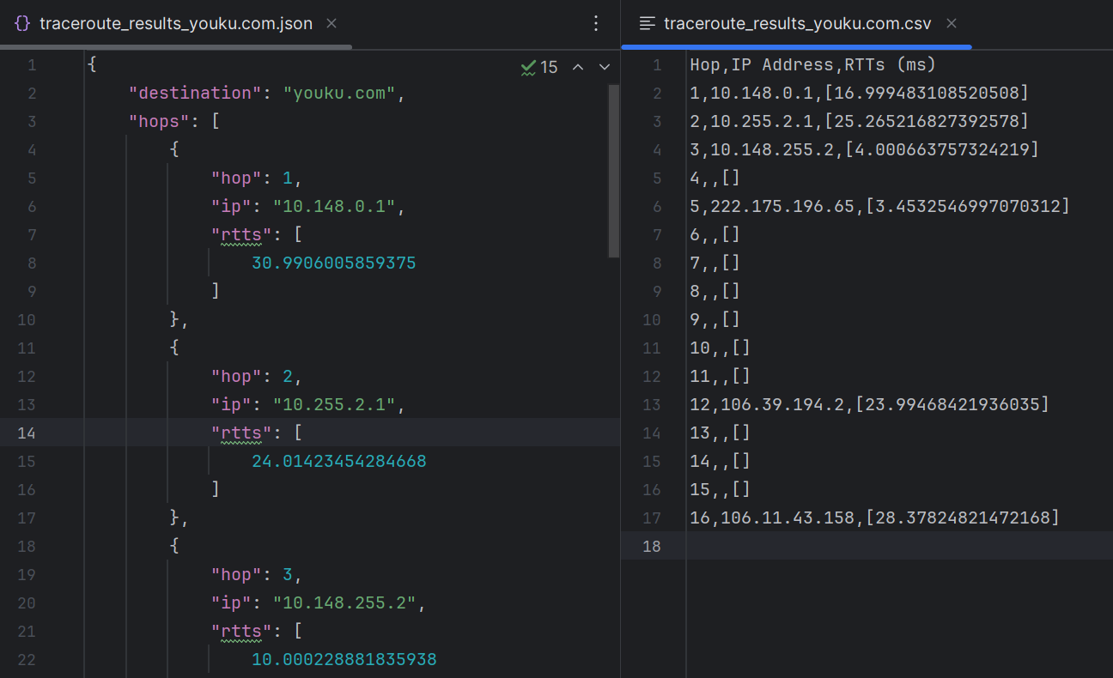
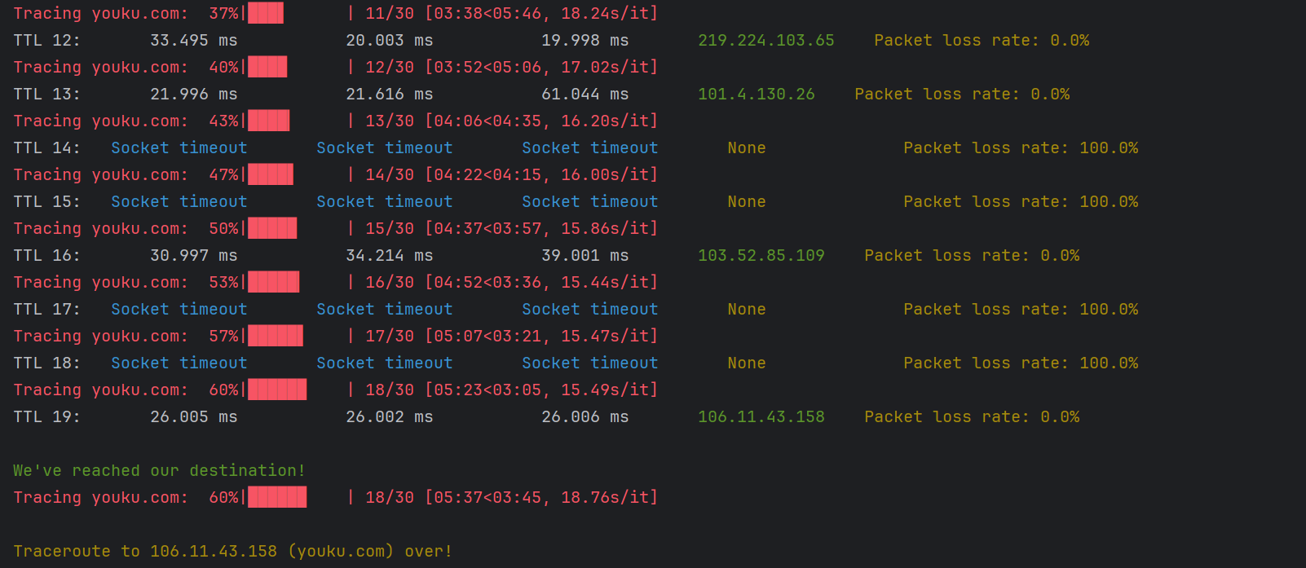
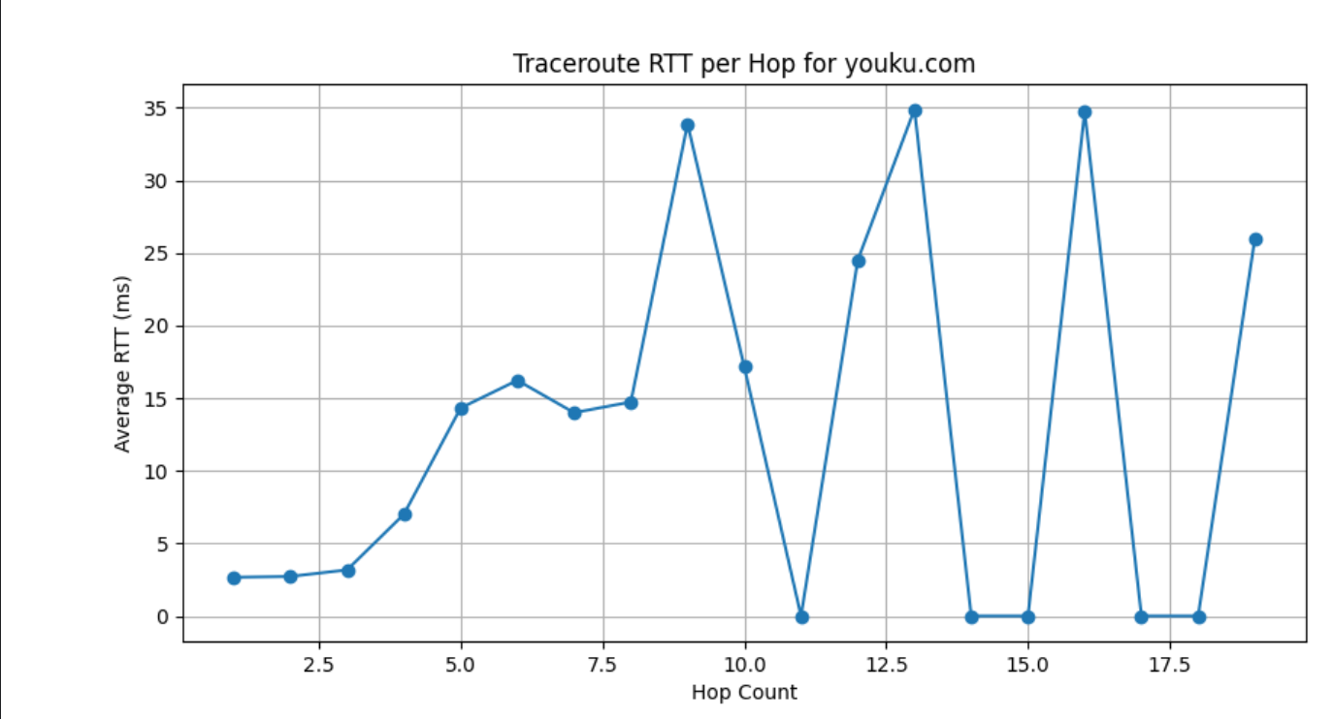
introduction
traceroute
packet
test
conclusion
Show the result
Using ICMP:
Progress bar display, beautify output
Storage each hop’s information: json / csv
RTT Visualisation

Slide 24
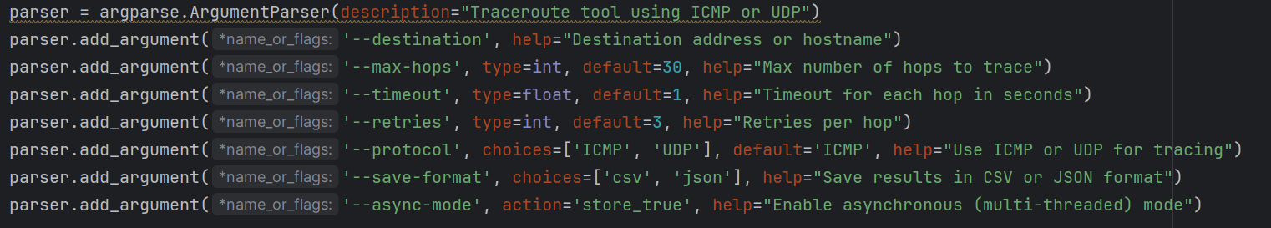
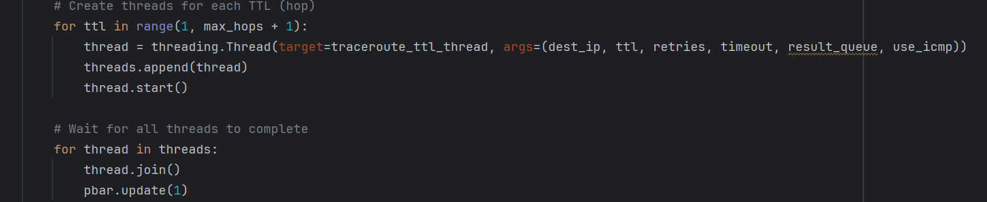
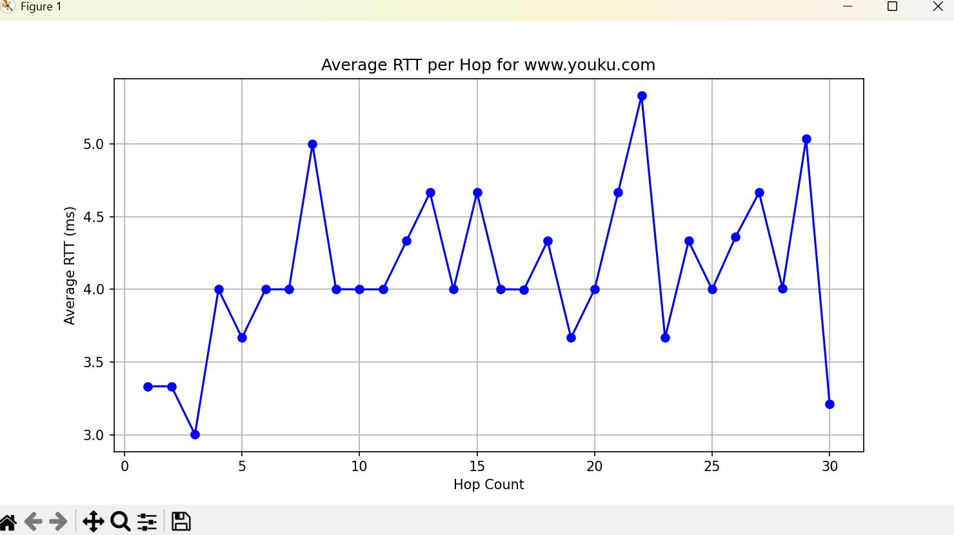
introduction
traceroute
packet
test
conclusion
Show the result
Using ICMP:
7 custom parameters
Multi-threaded asynchronous: dramatically improving traceroute efficiency
Traceroute time: 337 s -> within 1 s

Slide 25
05
PART
Conclusion

Slide 26


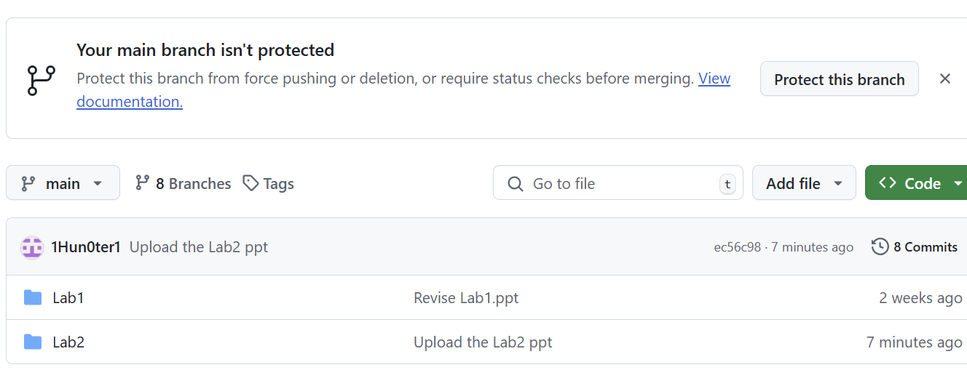
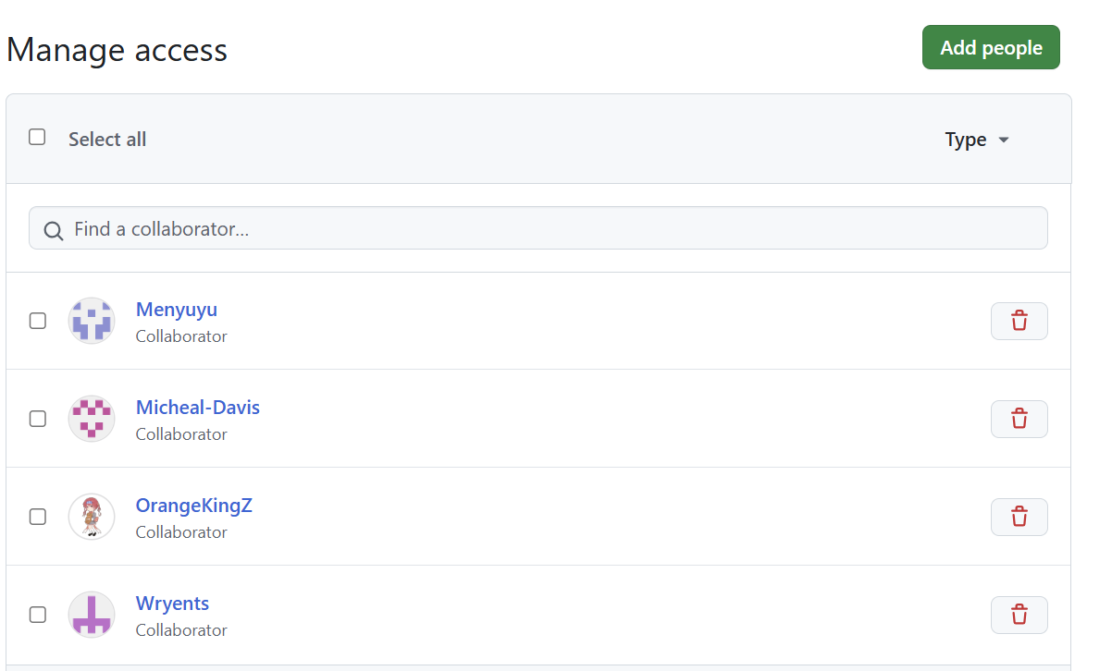
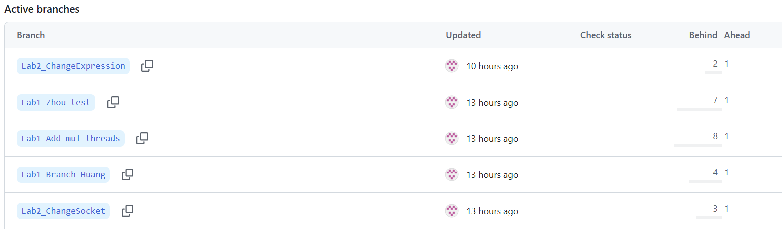
introduction
traceroute
packet
test
conclusion
Version control: Using Github
README.md
traceroute.py
.sh script
8 branches
5 collaborators

Slide 27
prepare
packet
process
test
conclusion
Summary of all functional implementations
Caculation of RTT for each TTL
Calculation of packet loss rate
16 kinds of exception handling
7 user input parameters
ICMP & UDP protocol
Multithreading (Efficient Option)
Extensive testing in Win & linux
RTT visualization
log storage(json & csv)

Slide 28
Thank you!
Huang Hao, Zhou Yitong, Meng Yu, Chen Zijie, Wen Tianshu
2024.10.24

